Slide 1

مبادرة وزارة الاتصالات وتكنولوجيا المعلومات لتمكين الشباب للعمل المهني الحر Youth Enablement for Freelancing

Slide 2
Web Development مطور صفحات انترنت

Slide 3
Computers and Artificial Intelligence website (CS & AI)

Slide 4
User Experience (UX) Design

Slide 5
CS & AI Website
This website to Faculty of Computers and Artificial intelligence and to help people who likes programming and wants to learn more about programming and learn how they start in this field.

Slide 6
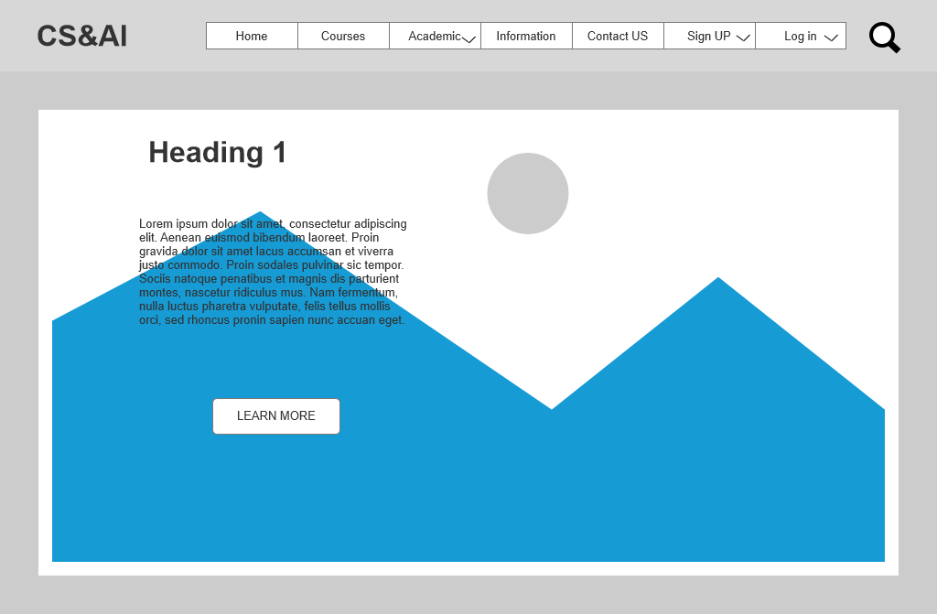
Home Page
It is the first and main page and it explain information about this website.

Slide 7
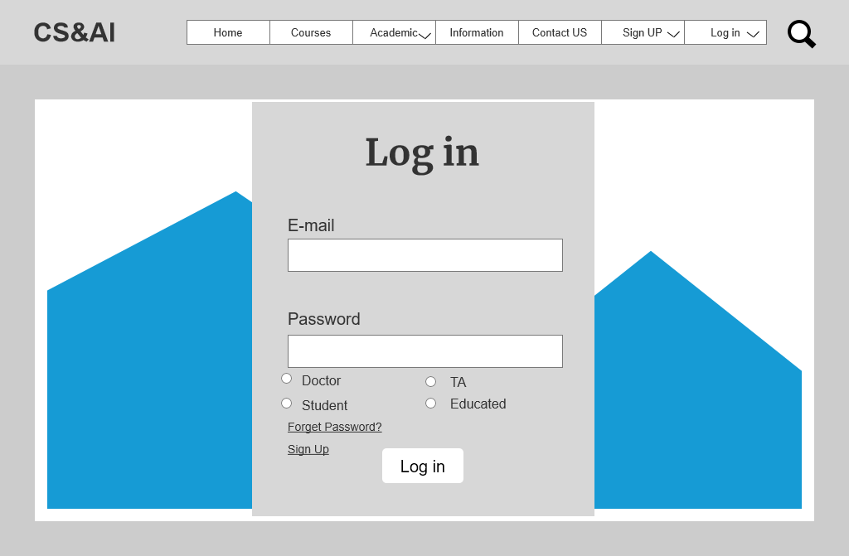
Log in Page
Anyone was signed up in this website you can log in by this page.

Slide 8
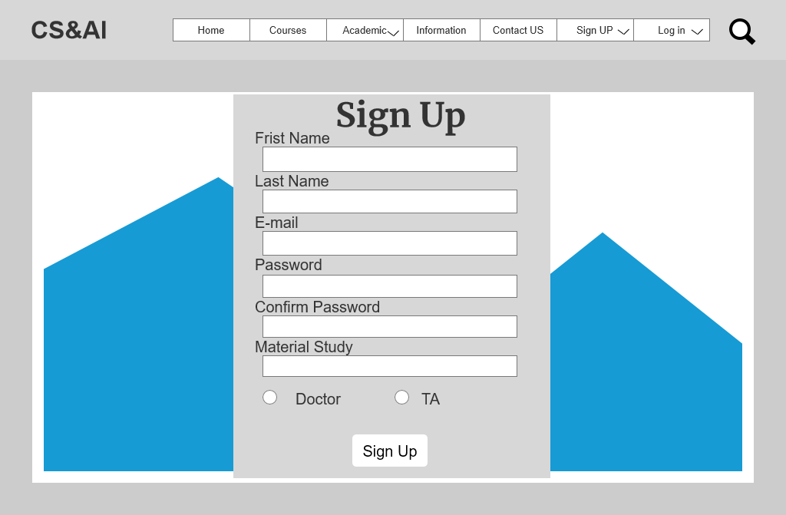
Sign Up Page_1
Doctors and TAs can sign up in this website by this page.
Sign up for Staff in College

Slide 9
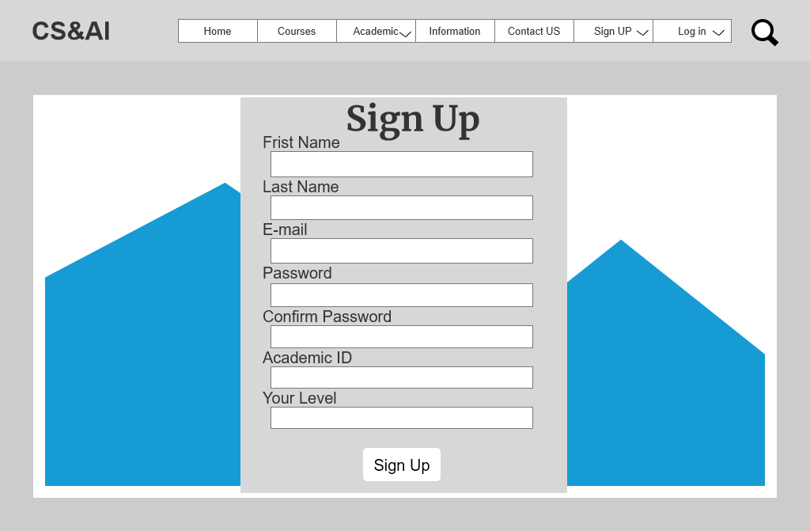
Sign Up Page_2
Students can sign up in this website by this page.
Sign up for student in College.

Slide 10
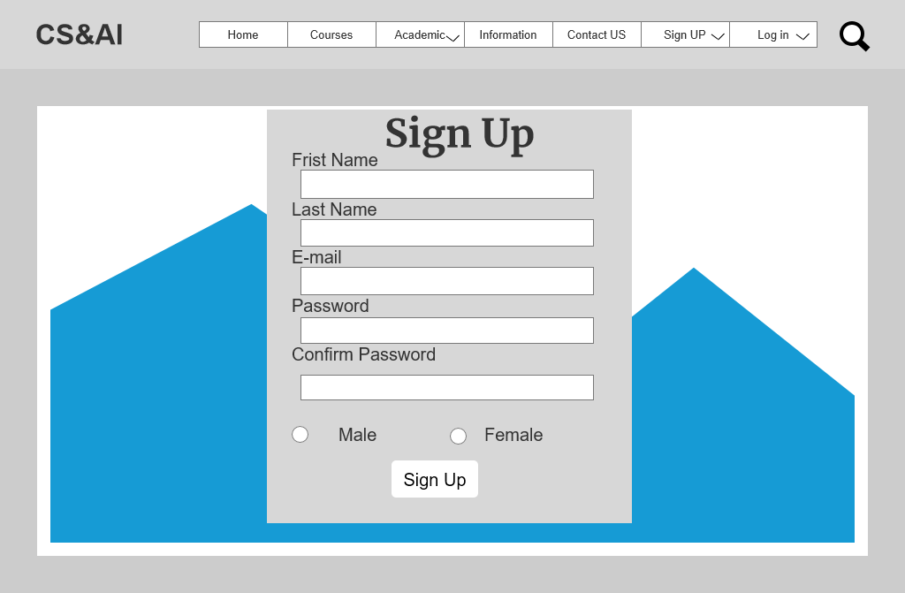
Sign Up Page_3
Person who wants to educate programming, can sign up in this website by this page.
Sign up for educated.

Slide 11
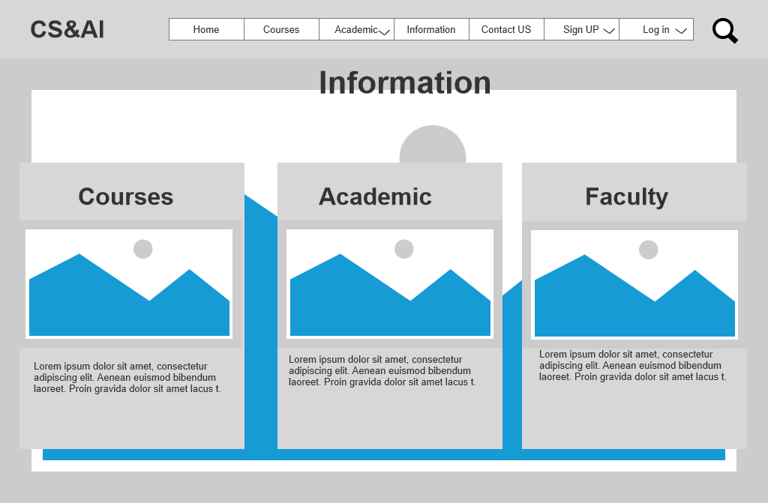
Information Page
Contains information about website benefits, administrator, College.

Slide 12
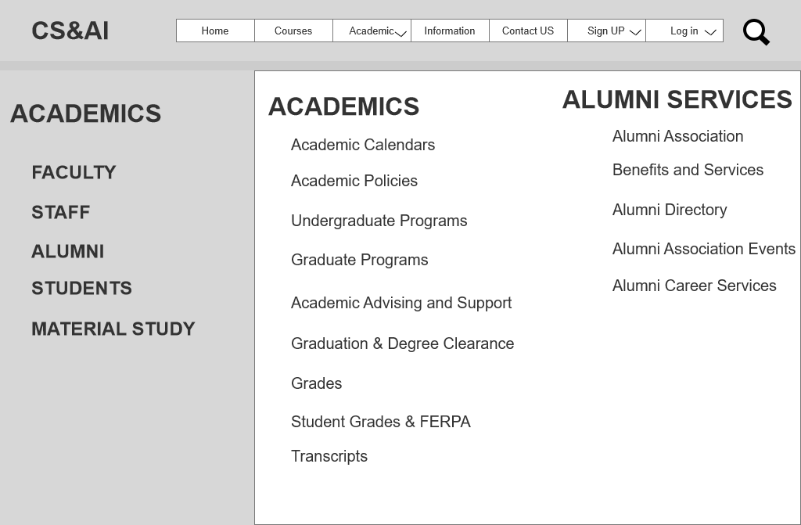
Academic Page
Contains information about staff, material study, majors, students, alumni and alumni services.

Slide 13
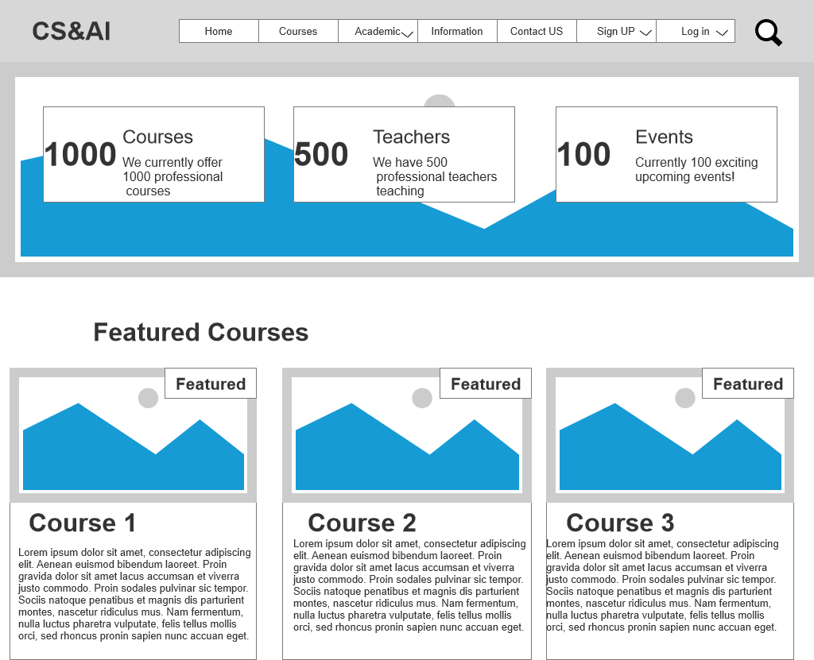
Courses Page
Contains helpful links of courses.
Anyone can start any courses for free to help him in programming.

Slide 14
User Interface (UI)Design

Slide 15

Home Page

Slide 16
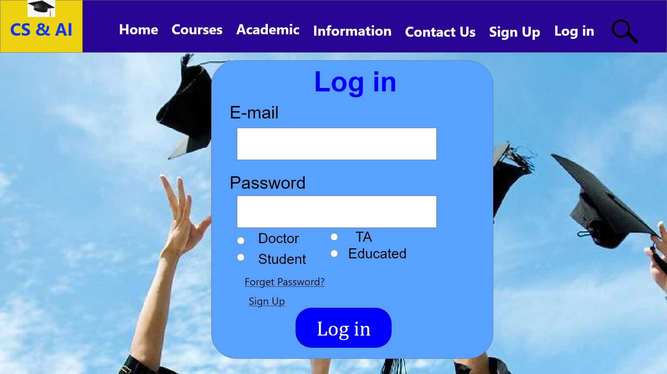
Log in Page

Slide 17
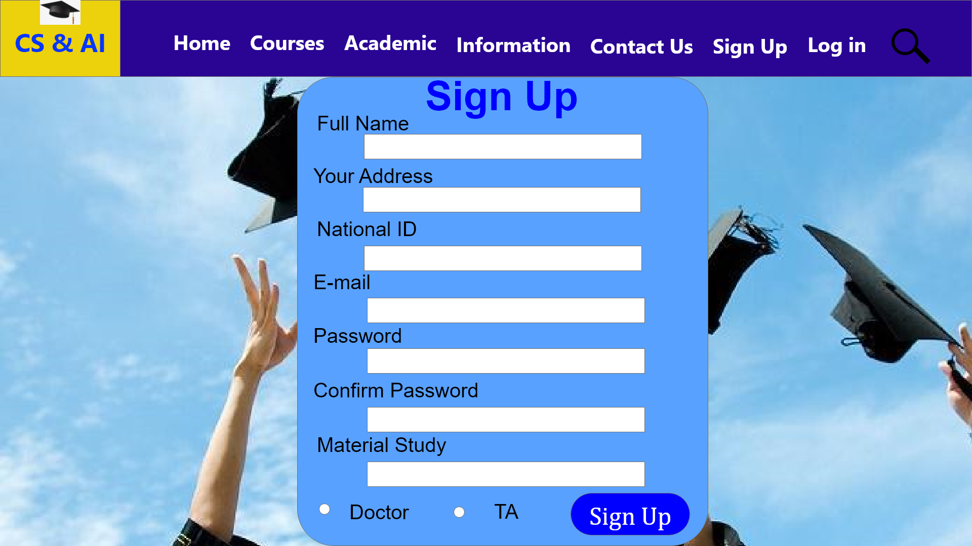
Sign Up Page_1

Slide 18
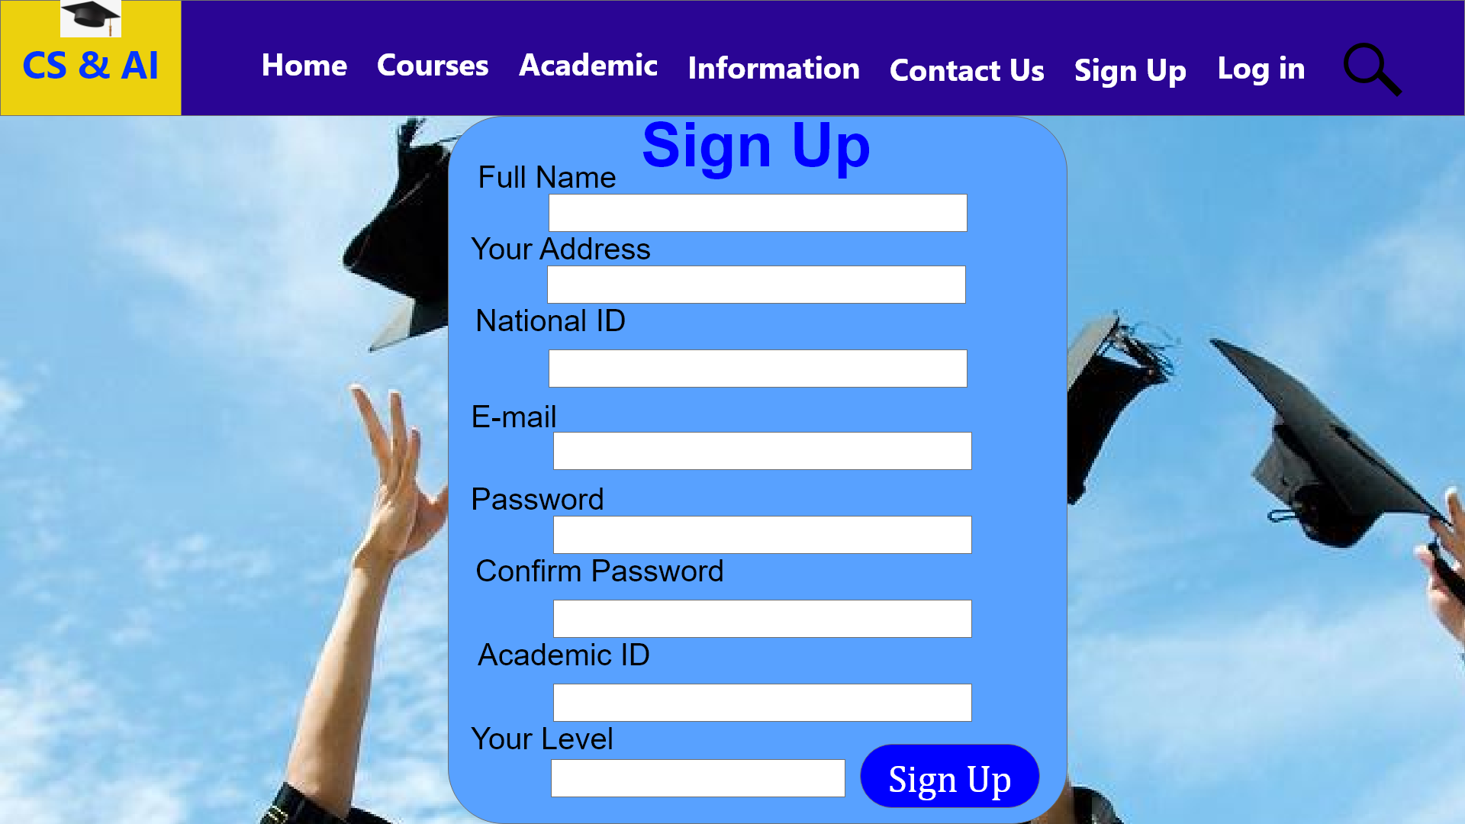
Sign Up Page_2

Slide 19
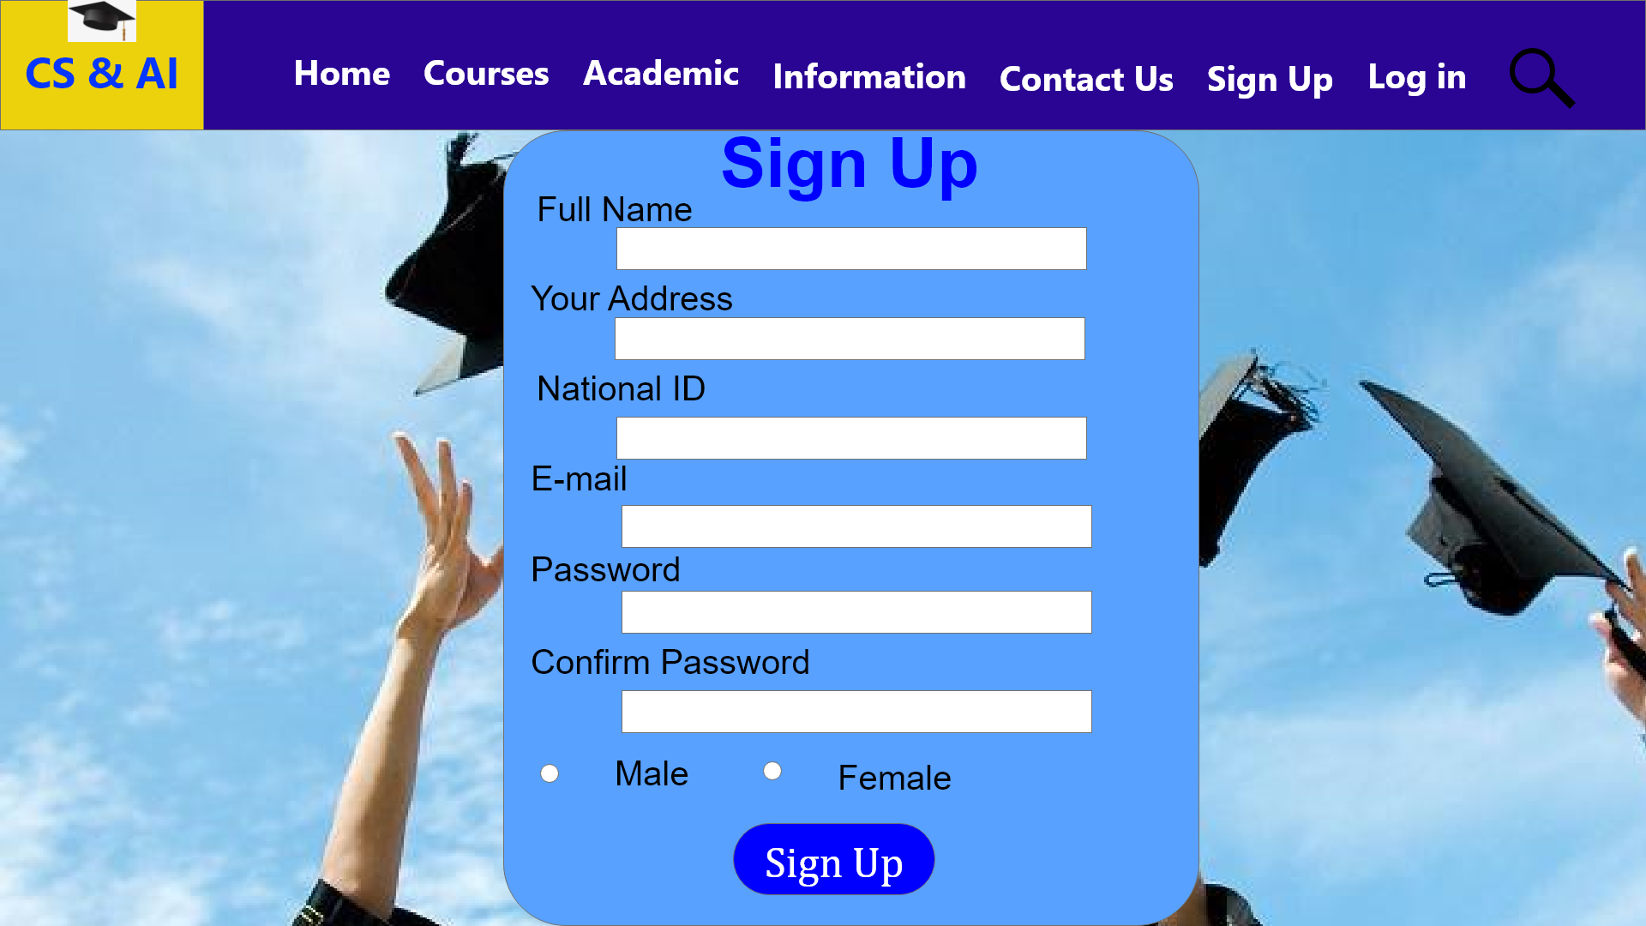
Sign Up Page_3

Slide 20
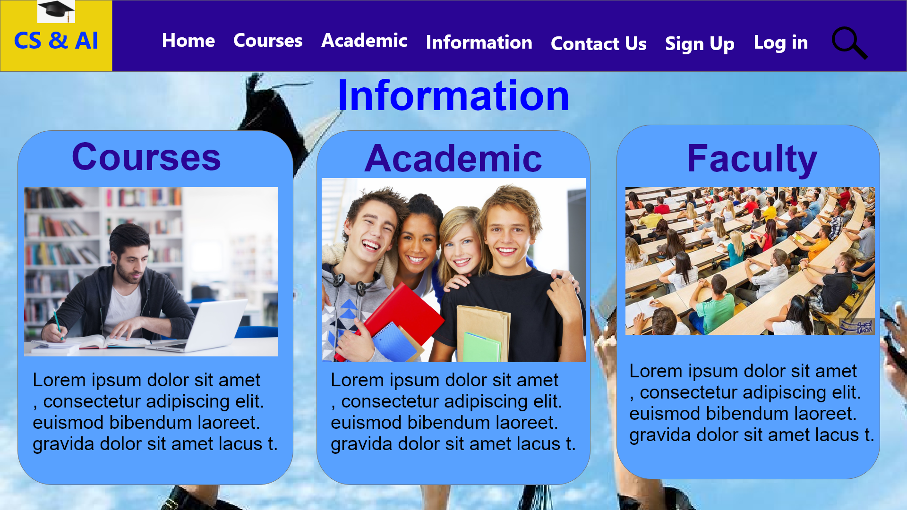
Information Page

Slide 21
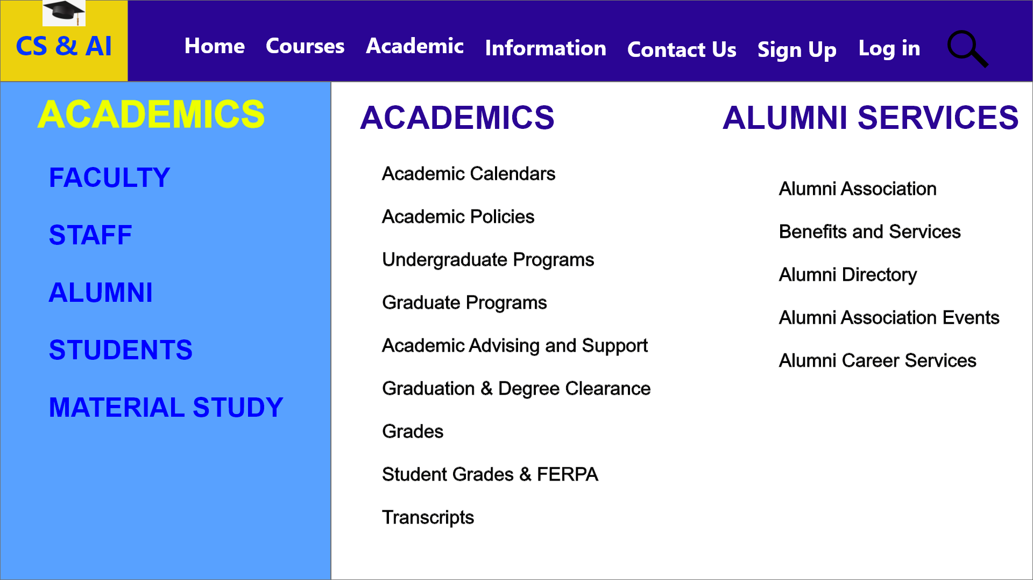
Academic Page

Slide 22
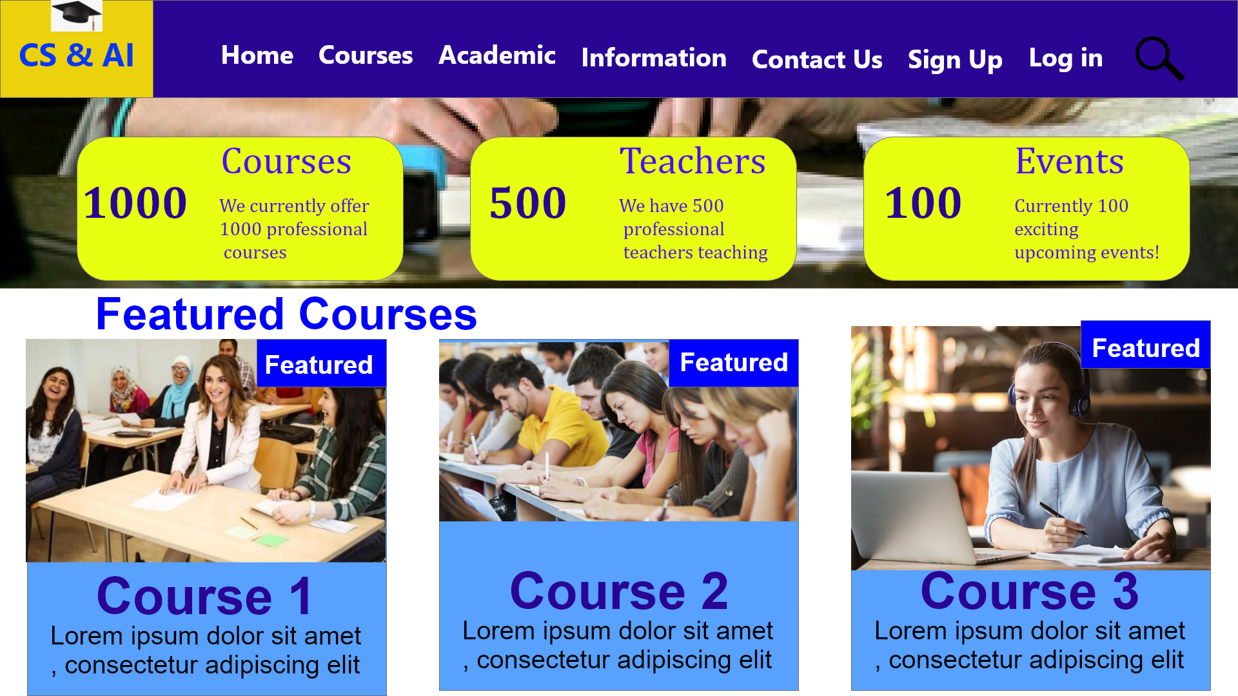
Courses Page

Slide 23
Front-End

Slide 24
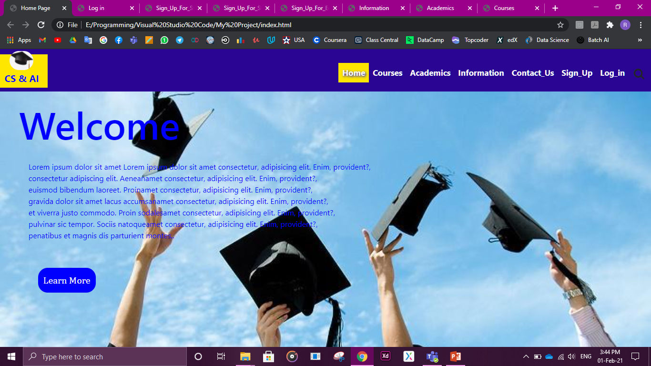
Home Page

Slide 25
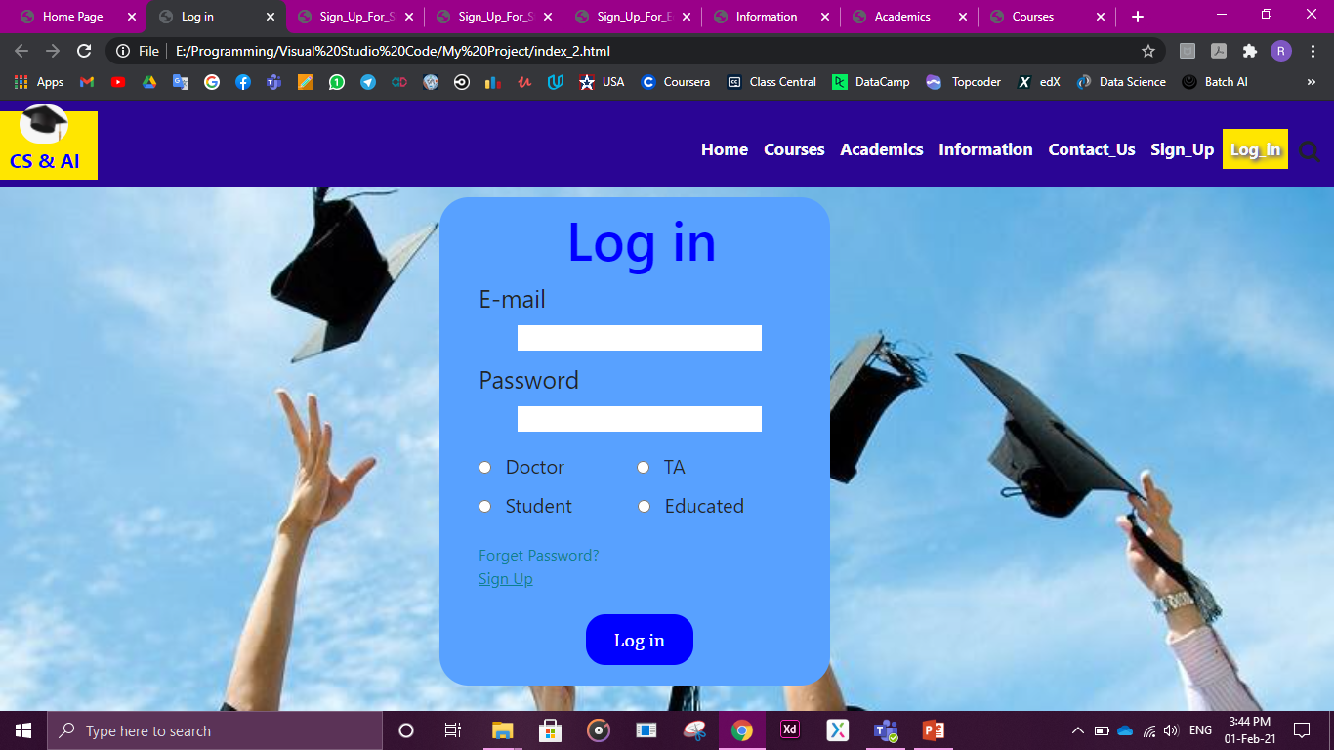
Log in Page

Slide 26
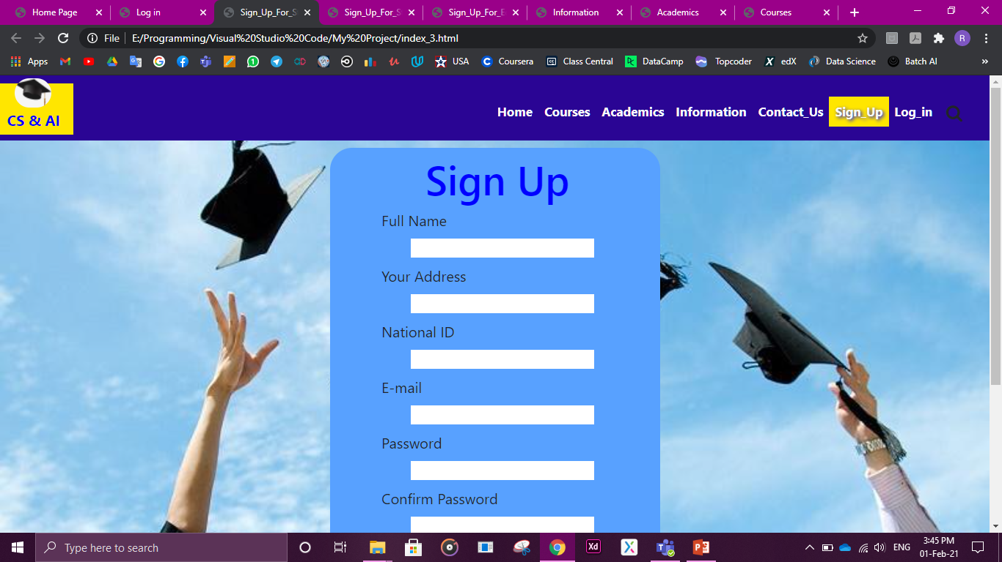
Sign Up Page_1

Slide 27
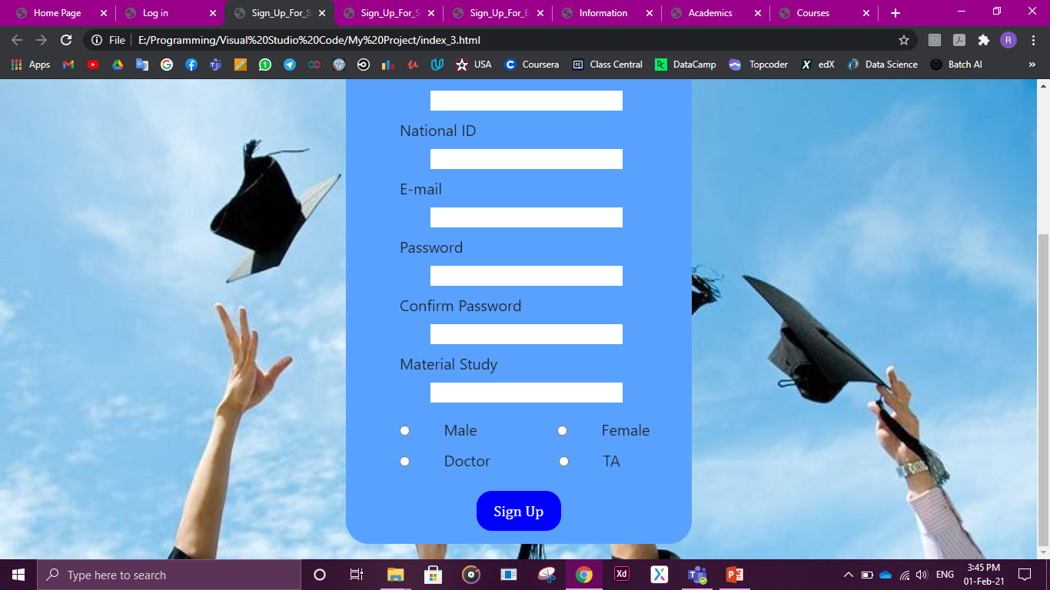

Slide 28

Sign Up Page_2

Slide 29
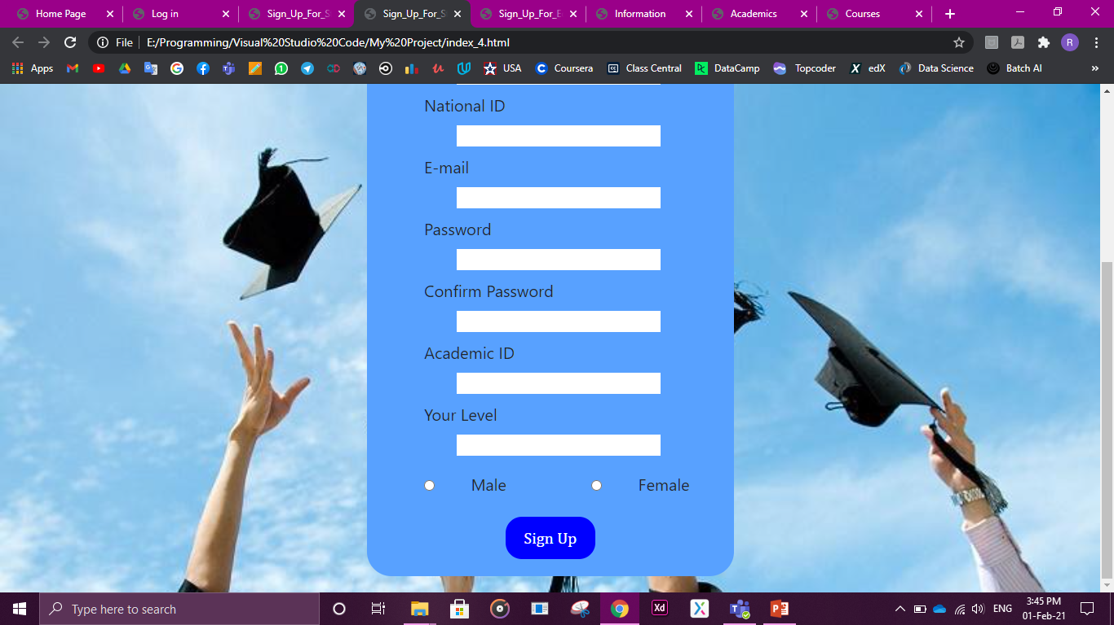

Slide 30
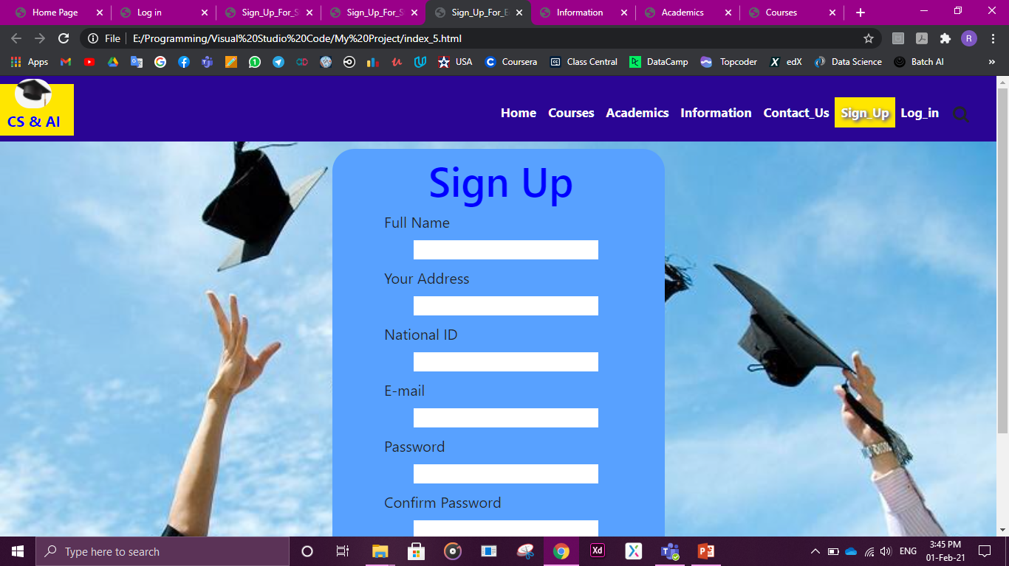
Sign Up Page_3

Slide 31
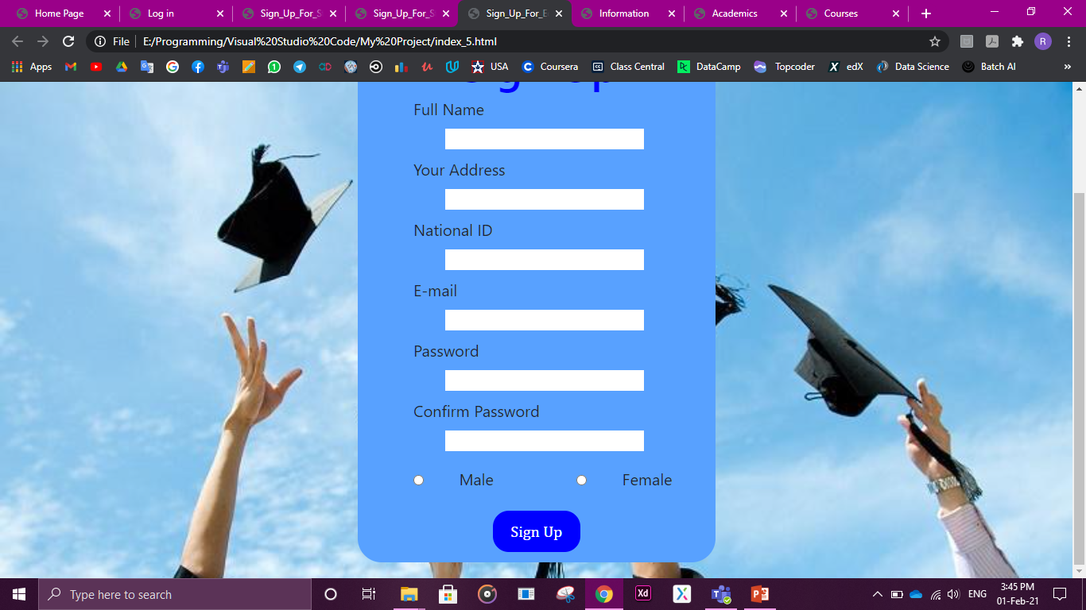

Slide 32
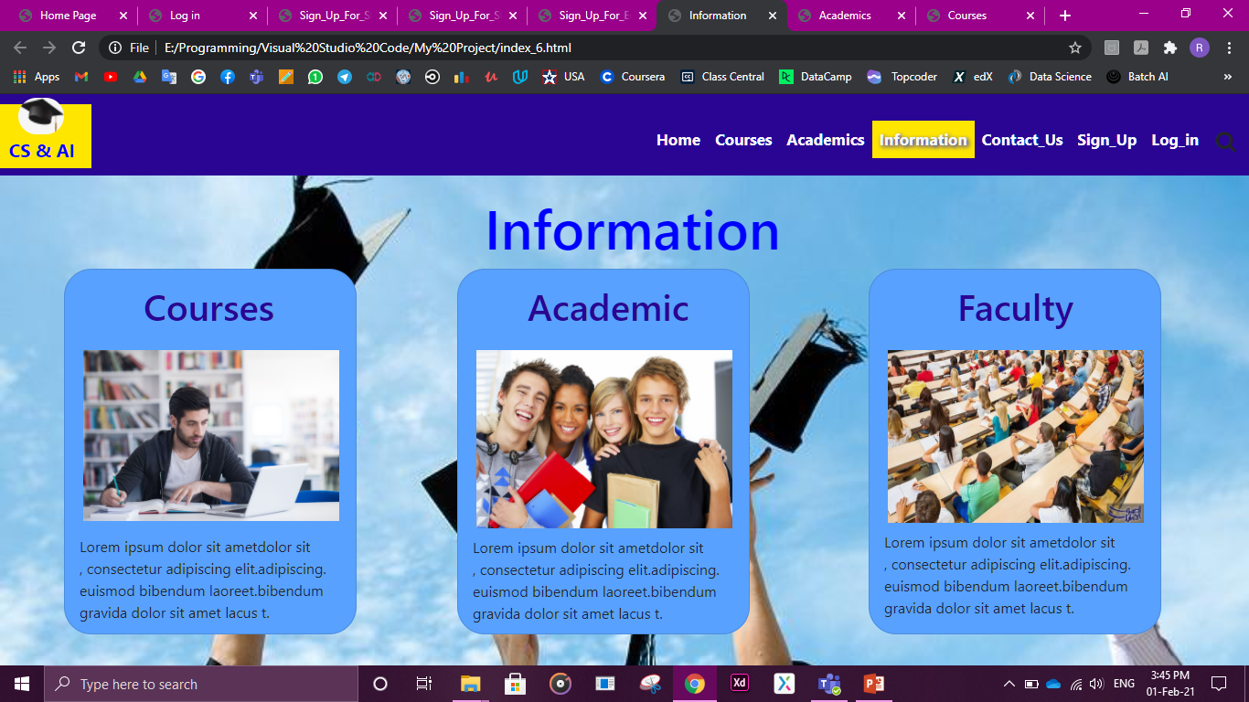
Information Page

Slide 33
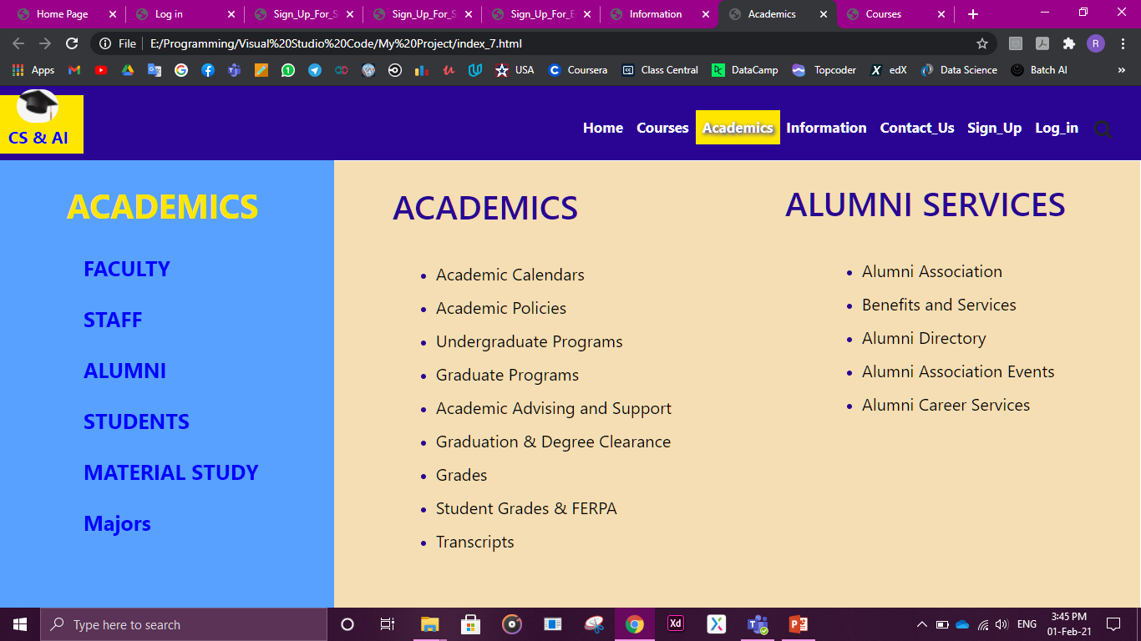
Academic Page

Slide 34
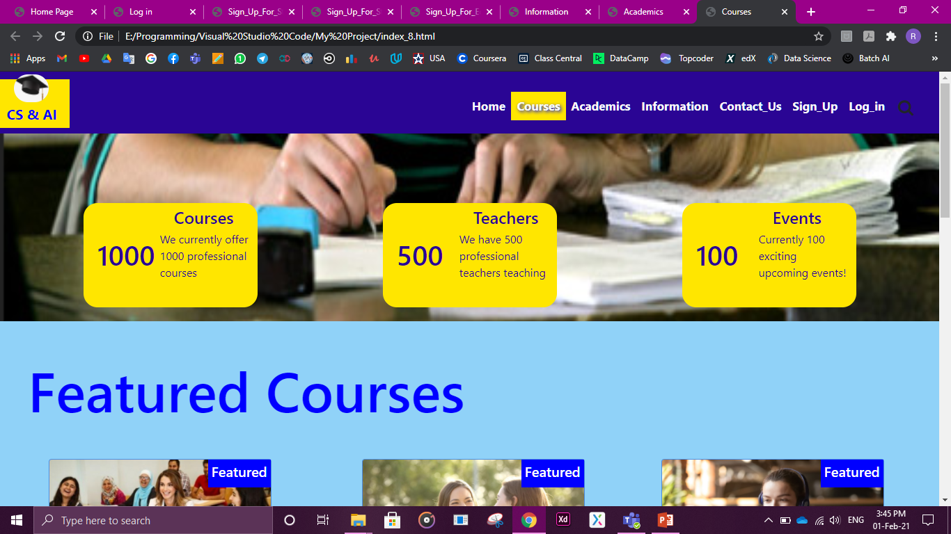
Courses Page

Slide 35
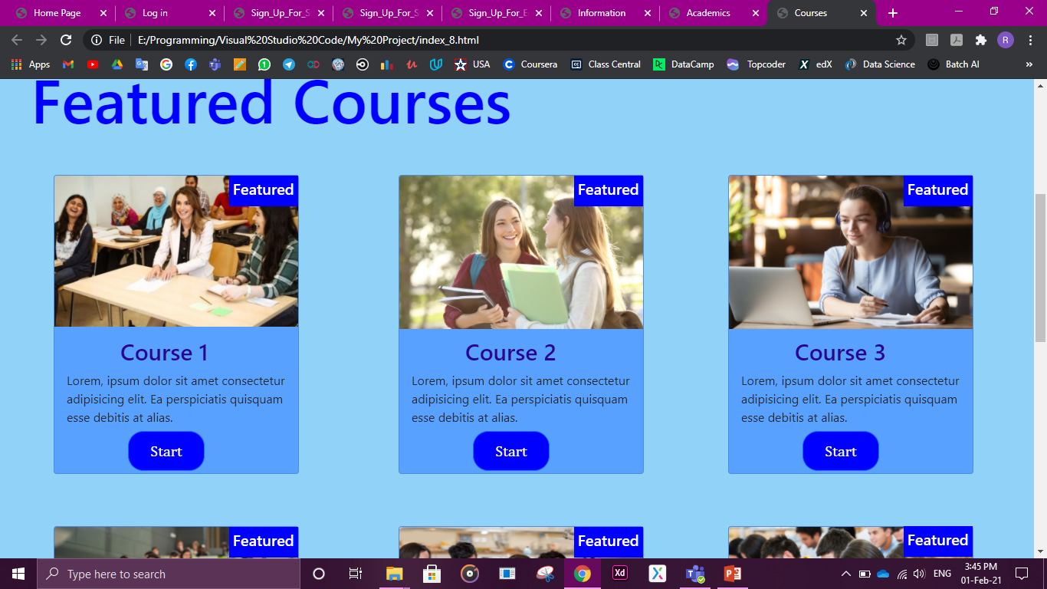

Slide 36
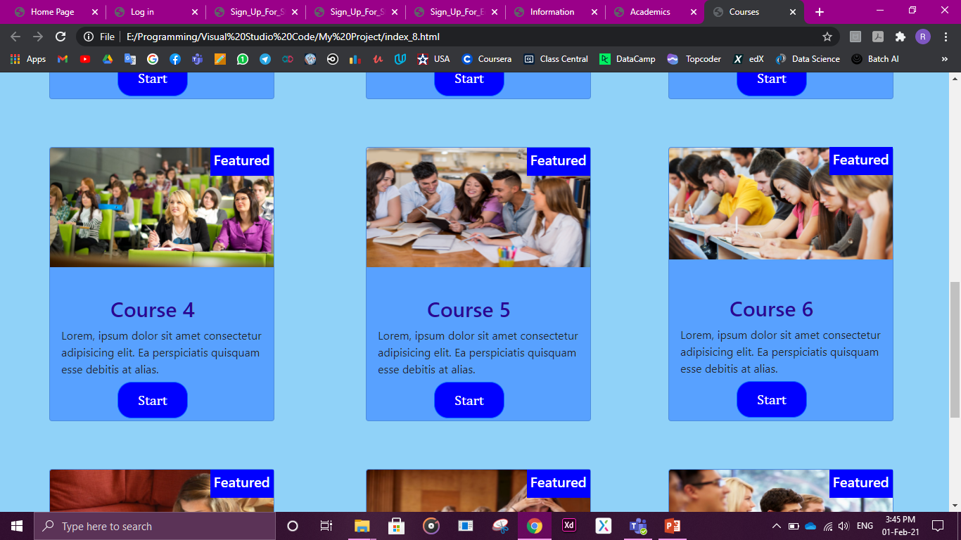

Slide 37
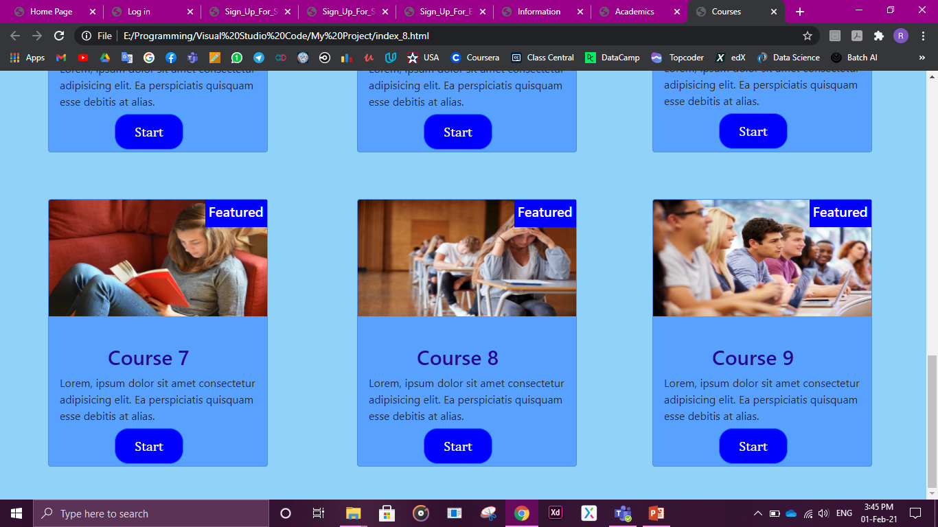

Slide 38


